Slide 1
About Java Object Oriented Programming, Class, Class Properties, Objects, new keyword, Object Creation and instanceOf keyword
-Pranali chougule

Slide 2
Java Object Oriented Programming
Java Object-Oriented Programming (OOP) is a paradigm that organizes software design around data, or objects, rather than functions and logic.
Object-oriented programming has several advantages over procedural programming:
OOP is faster and easier to execute
OOP provides a clear structure for the programs
OOP helps to keep the Java code DRY "Don't Repeat Yourself", and makes the code easier to maintain, modify and debug
OOP makes it possible to create full reusable applications with less code and shorter development time are design around data, or objects, rather than functions and logic.

Slide 3
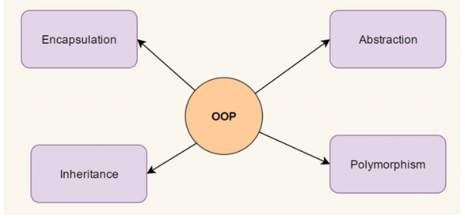
The four major features of object-oriented programming are:

Slide 4
Encapsulation
This is the bundling of data (variables) and methods (functions) that operate on the data into a single unit called a class.
It also restricts direct access to some of an object's components, which is called data hiding.
Access to the data is typically controlled using getter and setter methods.
EXAMPLE
class Student {
private String name; // Data hiding
public String getName()
{ // Getter
return name;
}
public void setName(String name) { // Setter
this.name = name;
}
}

Slide 5
Inheritance
This allows one class to inherit the properties and behavior (methods) of another class.
The class that inherits is called the subclass, and the class from which it inherits is called the superclass.
The keyword “extends” is used to inherit a class in Java.
The “extends” keyword indicates that we are making a new class that derives from an existing class.
EXAMPLE
class Animal {
void eat() {
System.out.println("This animal eats food.");
}
}
class Dog extends Animal {
void bark() {
System.out.println("The dog barks.");
}
}

Slide 6
Polymorphism
Polymorphism is one of the key concepts of Object-Oriented Programming (OOP) in Java, and it allows objects to be treated as instances of their parent class or interface.
Polymorphism enables a single method to perform different tasks based on the object it is acting upon.
Compile-time Polymorphism (Method Overloading): In method overloading, multiple methods in the same class have the same name but different parameter lists (type, number, or order of parameters). The compiler determines which method to invoke based on the arguments passed
Runtime Polymorphism (Method Overriding):In method overriding, a subclass provides a specific implementation of a method that is already defined in its parent class. At runtime, the JVM determines which method to call, based on the actual object type.

Slide 7
class Calculator {
// Method to add two integers
int add(int a, int b) {
return a + b;
}
// Method to add three integers (overloaded method)
int add(int a, int b, int c) {
return a + b + c;
}
// Method to add two doubles (overloaded method)
double add(double a, double b) {
return a + b;
}
}
public class Main {
public static void main(String[] args) {
Calculator calc = new Calculator();
// Method overloading based on different parameters
System.out.println(calc.add(5, 10)); // Output: 15 (calls add(int, int))
System.out.println(calc.add(5, 10, 20)); // Output: 35 (calls add(int, int, int))
System.out.println(calc.add(5.5, 10.3)); // Output: 15.8 (calls add(double, double))
}
}

Slide 8
Abstraction
It focuses on hiding the implementation details and showing only essential features.
Abstract classes and interfaces are used to achieve abstraction in Java.
EXAMPLE
abstract class Shape {
abstract void draw(); // Abstract method
}
class Circle extends Shape {
void draw() {
System.out.println("Drawing a circle.");
}
}

Slide 9
class
A class in Java is a set of objects which shares common characteristics/ behavior and common properties/ attributes.
It is a user-defined blueprint or prototype from which objects are created.
For example, Student is a class while a particular student named Ravi is an object.

Slide 10
Properties of Java Classes
Class is not a real-world entity.
It is just a template or blueprint or prototype from which objects are created.
Class does not occupy memory.
Class is a group of variables of different data types and a group of methods.
A Class in Java can contain:
Data member
Method
Constructor
Nested Class
Interface
A class contains:
Fields/Properties (Attributes): These are variables that store data relevant to the objects.
Methods (Behaviors): These define the actions that the objects can perform.

Slide 11
EXAMPLE
class Car {
// Fields (Class Properties)
String model;
String color;
int year;
// Methods (Class Behaviors)
void start() {
System.out.println("The car has started.");
}
void accelerate() {
System.out.println("The car is accelerating.");
}
}

Slide 12
Objects
.
In Java, an object is an instance of a class.
While a class serves as a blueprint, the object represents a specific implementation of that blueprint with its own unique data.
Objects are the fundamental units in Object-Oriented Programming (OOP) because they encapsulate data (state) and methods (behavior) in a single entity.
The state of an object is represented by its properties (fields).
Each object can have its own unique values for these properties.
The behavior is defined by the methods of the class, which perform operations on the object's state

Slide 13
Object creation
.
To create an object, you need to use the new keyword followed by the constructor of the class.
The constructor initializes the object's properties.
When you use new keyword, it allocates memory for the object in the heap and calls the constructor to initialize the object
we can create objects in Java by following ways
Using new keyword
Using new instance
Using clone() method
Using deserialization
Using newInstance() method of Constructor class

Slide 14
Steps during Object Creation
When new keyword is used, the following steps occur:
Memory Allocation: Memory is allocated in the heap to store the object.
Constructor Call: The constructor of the class is called to initialize the object's properties.
Reference Assignment: The reference variable (e.g., myCar) stores the address of the object, allowing you to access the object.

Slide 15
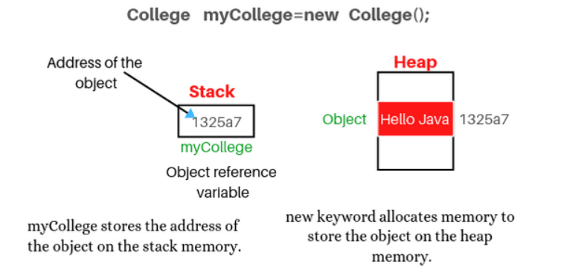

Slide 16
Syntax and example
EXAMPLE
class Car {
String model;
int year;
Car(String model, int year) {
this.model = model;
this.year = year;}}
public class Main {
public static void main(String[] args) {
Car myCar = new Car("Tesla", 2023);
System.out.println(myCar.model); // Output: Tesla
System.out.println(myCar.year); // Output: 2023
}
}
Syntax
ClassName objectName = new ClassName();

Slide 17
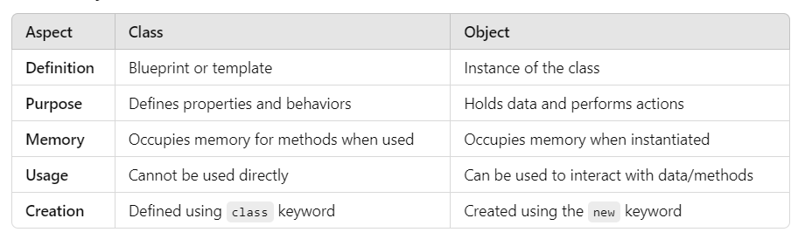

Slide 18
instanceof Keyword
The instanceof keyword in Java is used to check if an object is an instance (or subtype) of a specific class or interface.
It returns true if the object is an instance of the specified class or implements the interface, and false otherwise.
Use Cases of instanceof:
Type Checking: To confirm the runtime type of an object, especially in situations where polymorphism is used.
Avoiding ClassCastException: Before casting an object to a subclass, instanceof can be used to ensure the object is of the expected type.

Slide 19
EXAMPLE
class Animal {}
class Dog extends Animal {}
public class Main {
public static void main(String[] args) {
Animal myAnimal = new Animal();
Dog myDog = new Dog();
// Checking the type of objects
System.out.println(myAnimal instanceof Animal); // Output: true
System.out.println(myDog instanceof Dog); // Output: true
System.out.println(myDog instanceof Animal); // Output: true (since Dog is a subclass of Animal)
}
}
Syntax:
objectName instanceof ClassName

